Slide 1
Virtual Reality

Slide 2
Overview
Introduction
Why VR
Types of VR
VR Designs Components
Important Factor in VR Systems
VR Devises
VR Future

Slide 3
Introduction
An artificial environment created with computer hardware and software and presented to the user in such a way that it appears and feels like a real environment.

Slide 4
Why VR?
VR is able to immerse you in a Computer generated world of your own making: a room, a city, the interior of human body. With VR, you can explore any uncharted territory of the human imagination.

Slide 5
Type of VR Systems
Window on World (WoW)
Immersive VR
Non-Immersive VR
Telepresence
Distributed VR

Slide 6
Window on World (WoW)
Using a conventional computer monitor to
display the 3D virtual world.
To make the picture in the window look real, sound real and the objects act real.

Slide 7
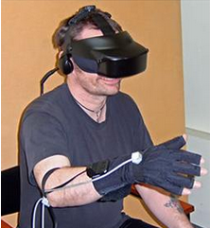
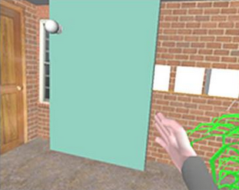
Immersive VR
Completely immerse the user's personal viewpoint inside the virtual 3D world.
The user has no visual contact with the physical word.
Often equipped with a Head Mounted Display (HMD).

Slide 8
Non-Immersive
Text-based VR:
when a reader of a certain text form a mental model of this virtual world in their head from the description of people , places and things.
Augmented VR:
the idea of taking what is real and adding to it in some way so that user obtains more information from their environment.

Slide 9
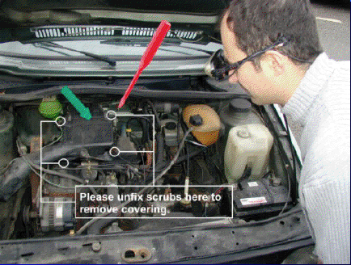
Augmented VR

Slide 10
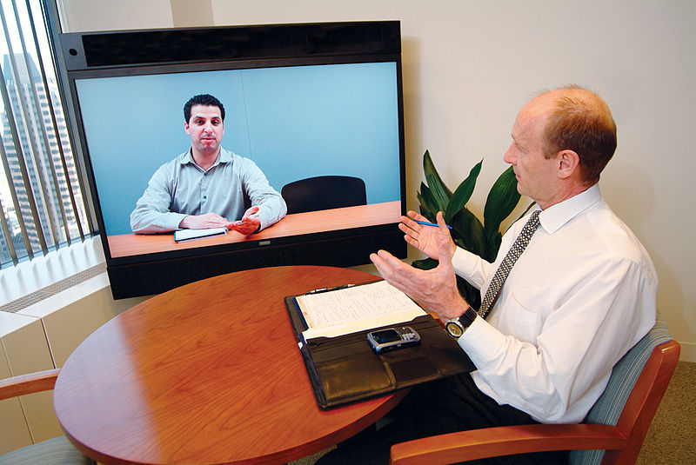
Telepresence
Telepresence refers to a set of technologies which allow a person to feel as if they were present, to give the appearance of being present

Slide 11
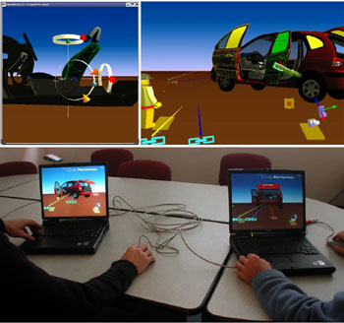
Distributed VR
A simulated world runs on several computers which are connected over network and the people are able to interact in real time, sharing the same virtual world.

Slide 12
VR Design
Six main components
Virtual World (Database of scenes)
Graphic engine (Define viewport)
Simulation engine (control change w.r.t users)
User interface
User Inputs
User Outputs

Slide 13
Important Factor in VR Systems
Visual Realism “fool the user’s senses”
Image Resolution “environment based”
Frame Rate “continuous &smooth picture”
Latency “degree of realism”

Slide 14
Applications of VR
Virtual Reality is often used to describe a wide variety of applications.
Flight Simulation
Learn to Drive a Car Virtually
Learn hang-glider Virtually
Architecture
Medicine
Entertainment
And so on….

Slide 15
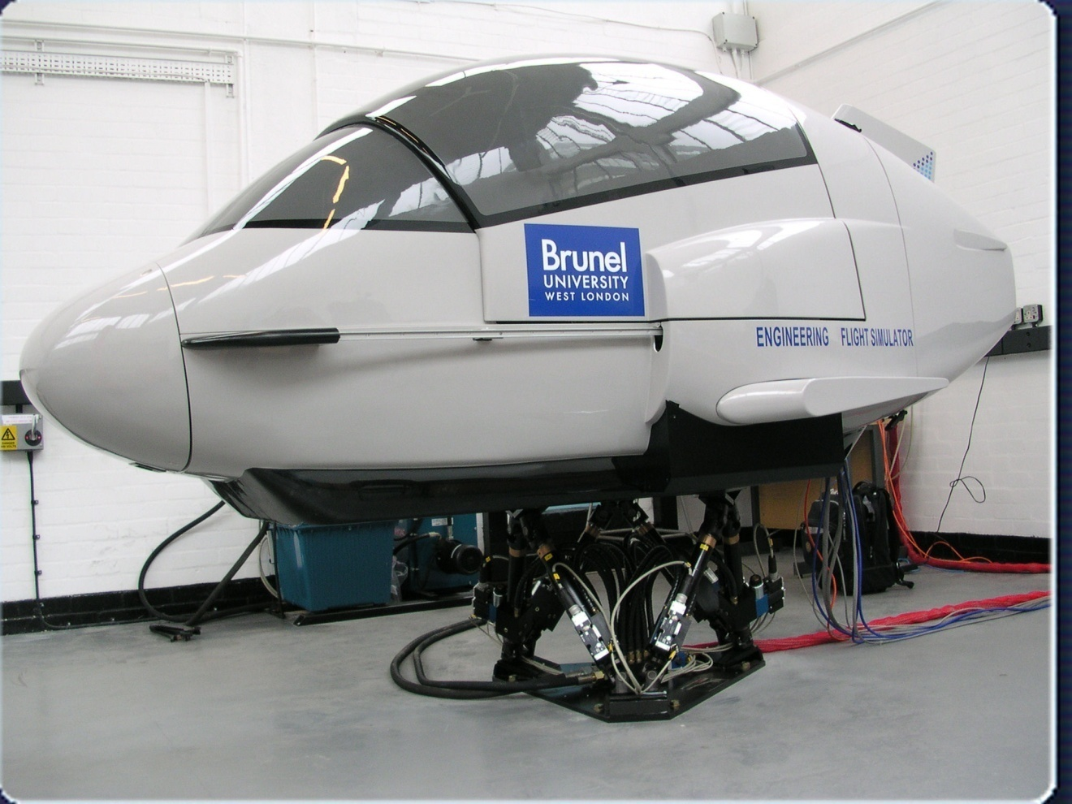
Flight Simulation

Slide 16
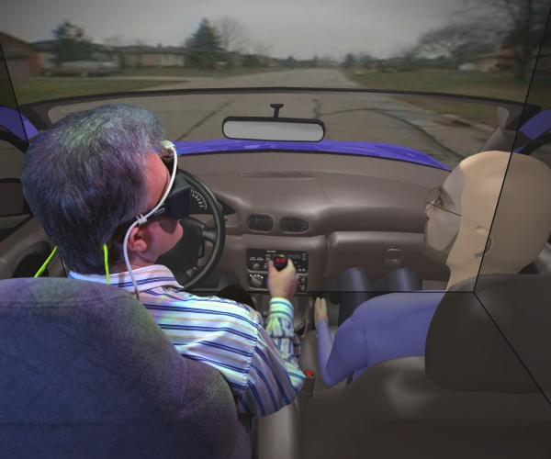
Learn to Drive a Car Virtually

Slide 17
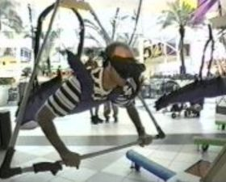
Learn hang-glider Virtually

Slide 18
VR Devices
Cyber Touch Gloves
Head Mounted Display
Boom
Cave
Data Suit
Omni directional Treadmills
Cyber Carpet
Virtual Globe
Virtual Keyboard

Slide 19
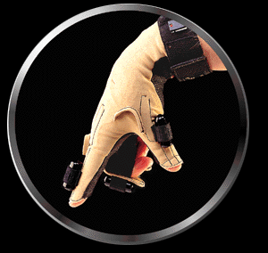
Cyber Touch Gloves
The Glove has six small vibro-tactile stimulators on the fingers and the palm.
Each stimulator can be individually programmed to vary the strength of touch sensation.

Slide 20
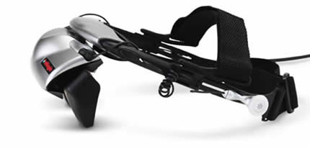
Head Mounted Display
The highly responsive head-tracking system provides a full 360-degree angle of view and specially developed optics deliver a bright, crisp image with a nearly 40 deg field of view.

Slide 21
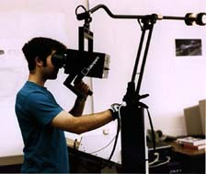
Boom
The BOOM (Binocular Omni-Orientation Monitor) from Fakespace is a head-coupled stereoscopic display device.

Slide 22
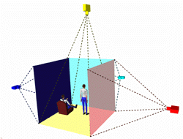
CAVE
The CAVE (Cave Automatic Virtual Environment)
provides the illusion of immersion by projecting stereo images on the walls and floor of a room-sized cube.

Slide 23
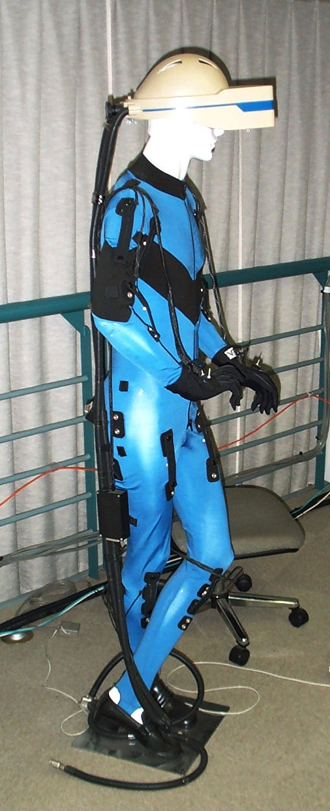
Data Suit
A full-body outfit with sensors for measuring the movement of arms and legs.

Slide 24
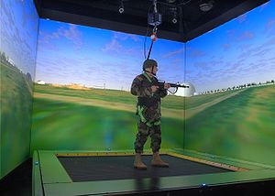
Omni directional Treadmills
An omnidirectional treadmill, or ODT, is a device that allows a person to perform locomotive motion in any direction.

Slide 25
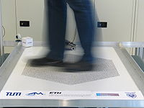
Cyber Carpet

Slide 26
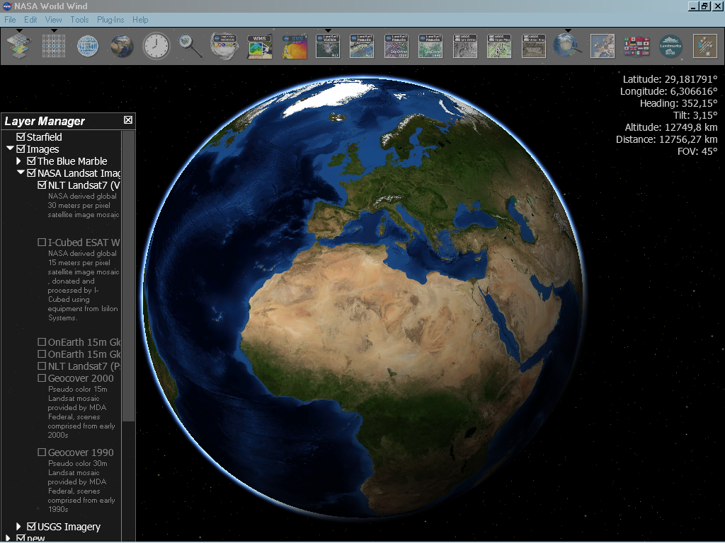
Virtual Globe
virtual globe is a 3D software model or representation of the Earth or another world. A virtual globe provides the user with the ability to freely move around in the virtual environment by changing the viewing angle and position

Slide 27
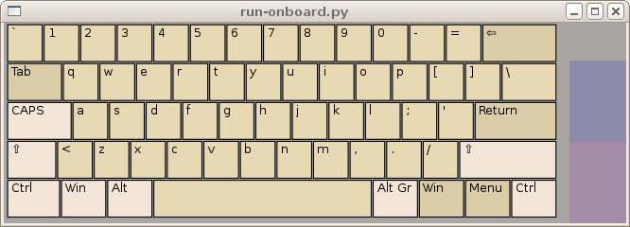
Virtual Keyboard
Virtual keyboards, such as the I-Tech Virtual Laser Keyboard, project an image of a full-size keyboard onto a surface.

Slide 28
Future of VR
It is difficult to predict the future of virtual reality with confidence. It is still very much in the development stage with many users creating their own customized applications and setups to suit their needs.

Slide 29


